Slide 1
Hello Watch! Build your First Apple Watch App
Kristina Fox
Senior iOS Engineer, Intuit
@krstnfx
Download project files:
bit.ly/ghcwatch
Notes:
download the project file
have xcode
LAUNCH XCODE NAO
if wifi isn't working, use USB sticks
otherwise pair up with a neighbor

Slide 2

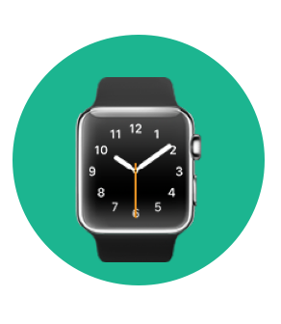

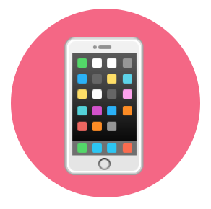
Hi, I’m Kristina!

Slide 3
Workshop Agenda
Intro to Apple Watch Development
Counter App with iPhone Companion App
Apple Ecosystem
Resources and Q&A
Notes:
slightly more complicated Counter App with iPhone companion app

Slide 4
Apple Watch

Slide 5
Apple Watch
Notes:
Introduced in 2014 – Most personal wearable device apple has ever created
Use cases for this are much different than any mobile device created before
Applications of health & fitness, tracking, etc. Only the beginning

Slide 6
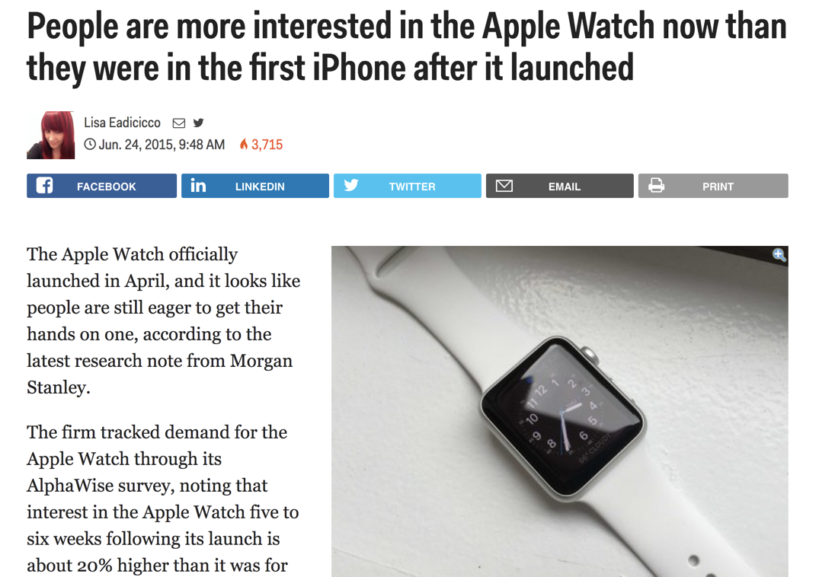

Slide 7
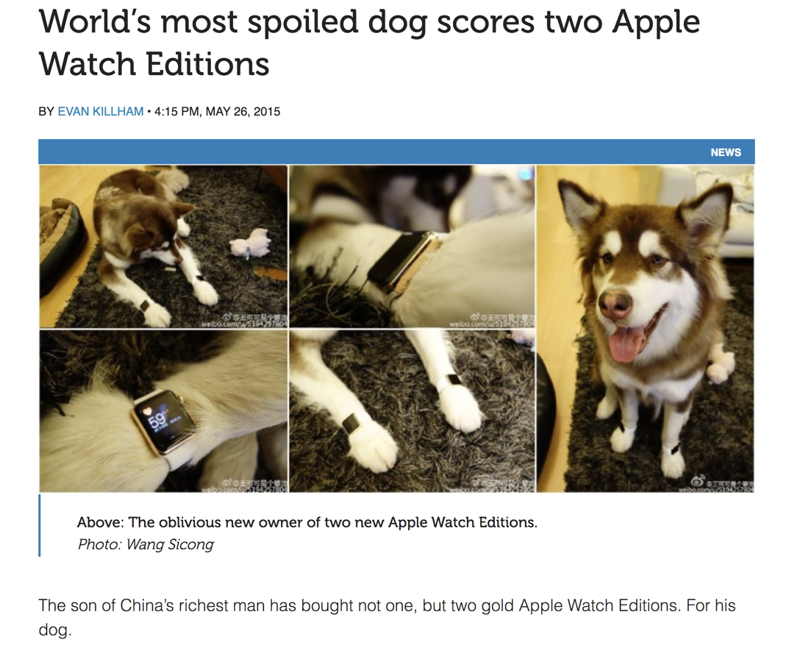

Slide 8
Apple Watch Communication Architecture

Slide 9
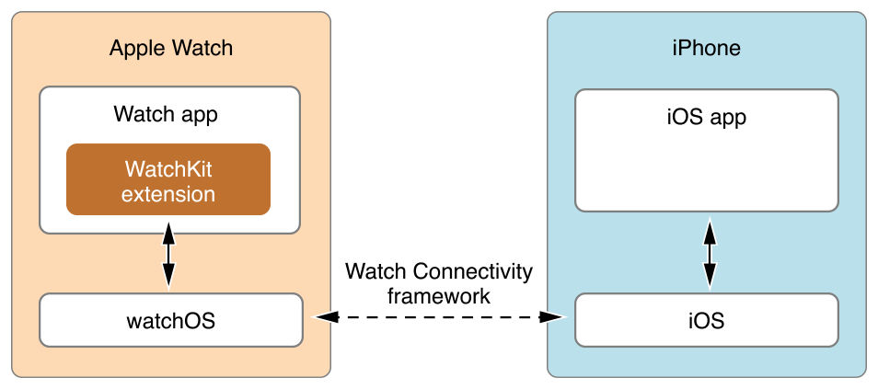
Apple Watch Communication Architecture
Notes:
Jump to other deck to do demo of how watch connectivity works

Slide 10
Hello Watch! App

Slide 11
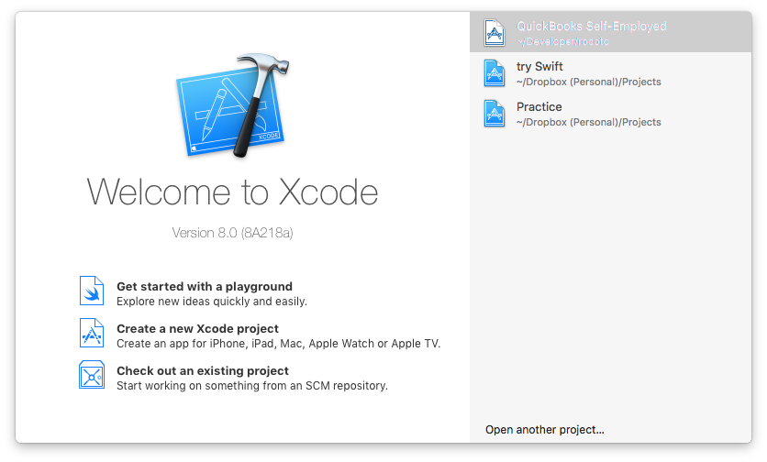
Hello Watch Application

Slide 12
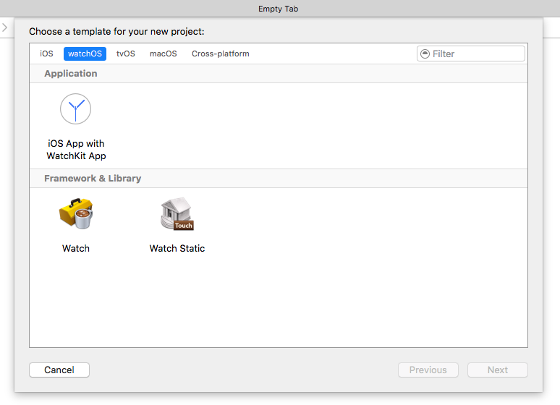
Choose App Type

Slide 13
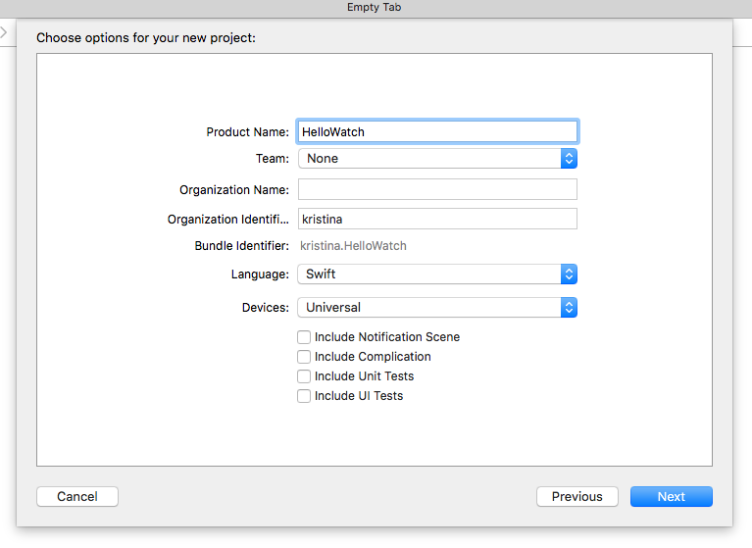
Name Your Project
Notes:
Press Next, and save where ever you’d like to save the project. Once you choose that location, press Create

Slide 14
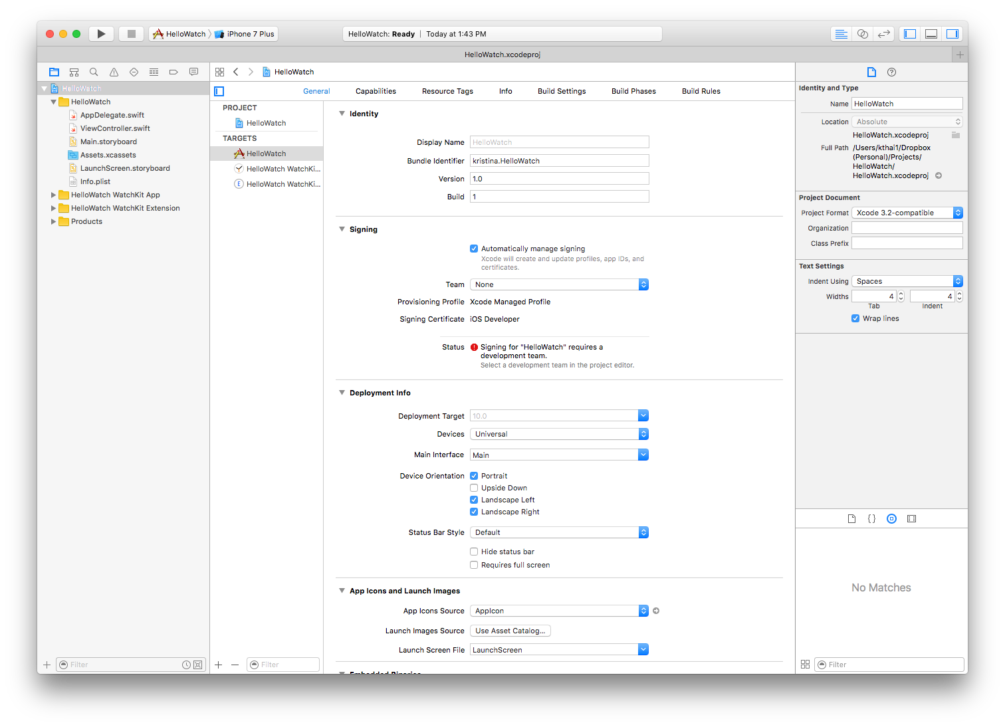
You’re In!

Slide 15
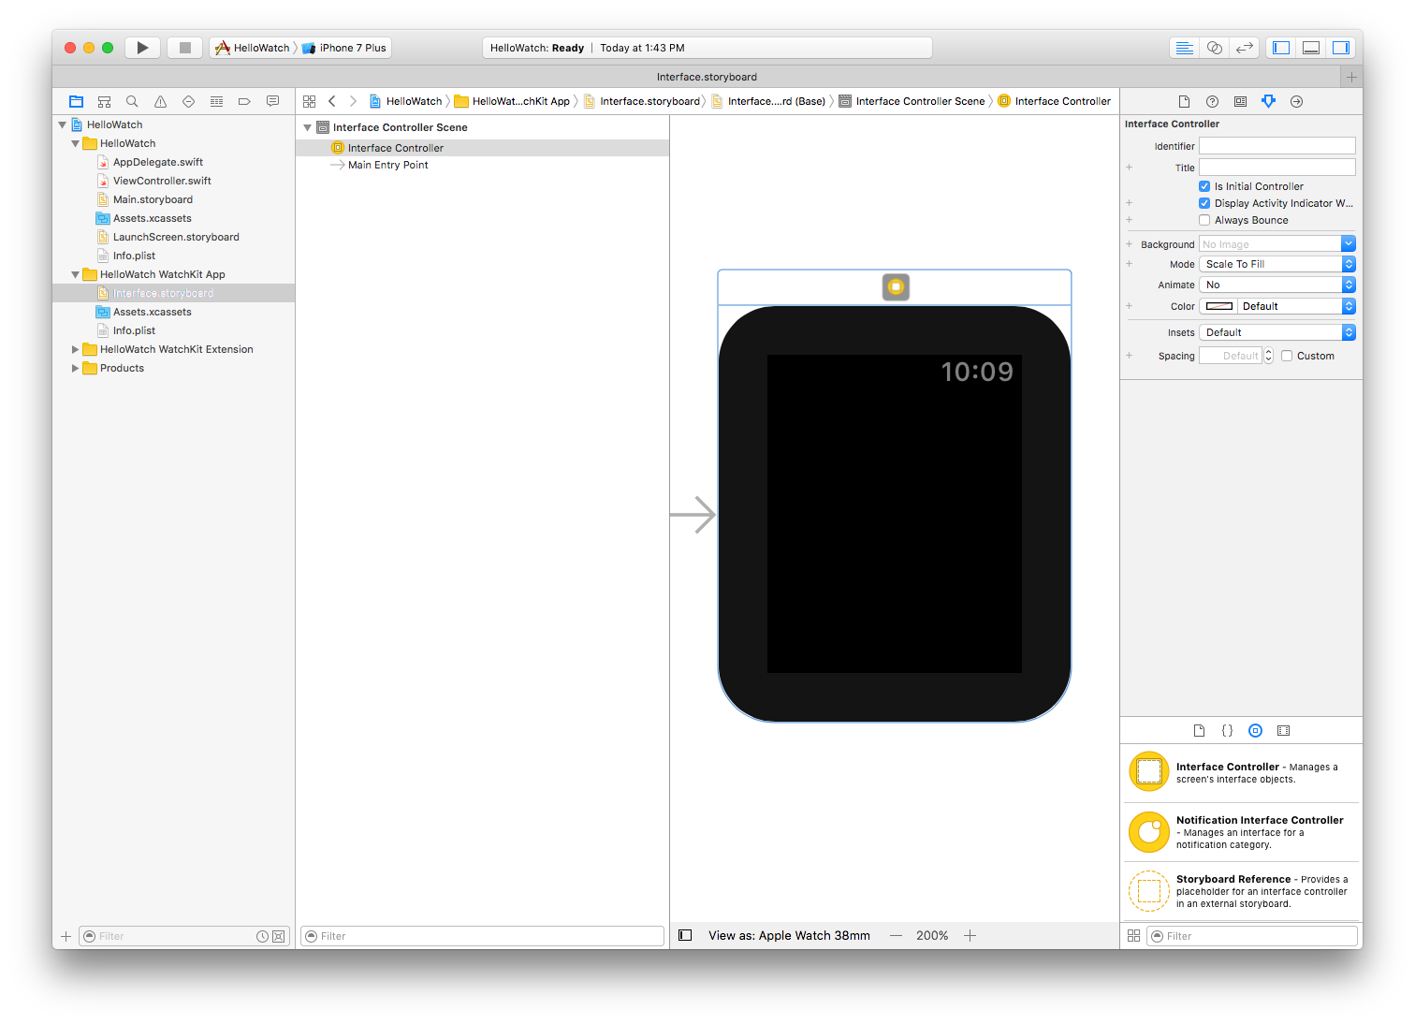
Build the Interface
Notes:
On left side bar, Click on Hello Watch WatchKit App
Blank watch face

Slide 16
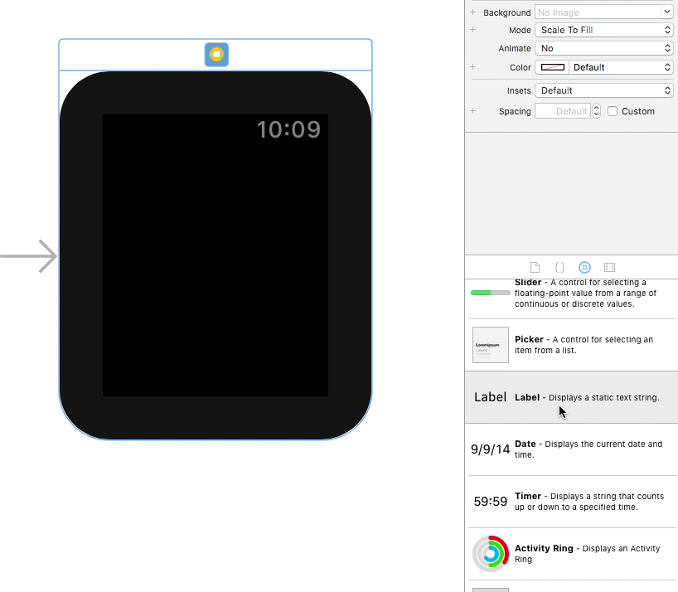

Drag the Label
Notes:
On the bottom half of the right sidebar, click on icon in the shape of a Circle with a square inside it (3rd from the left)

Slide 17
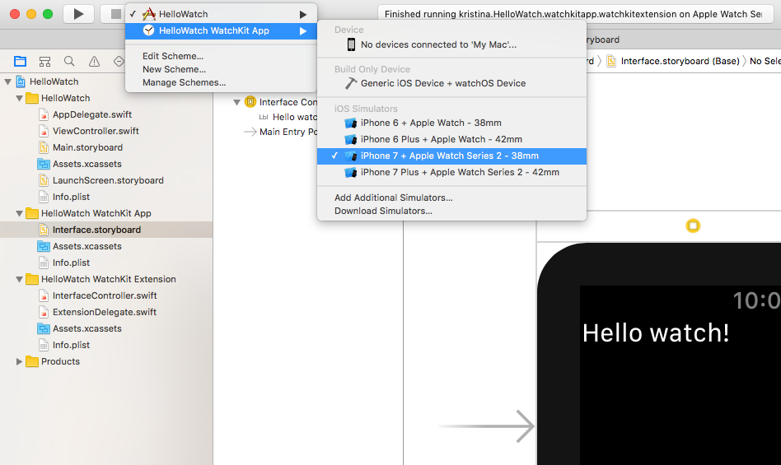
Pick a Scheme…and Run!
Notes:
Once you click run, it’ll take a while before you see the app come up. Ignore phone app (nothing will happen there)

Slide 18
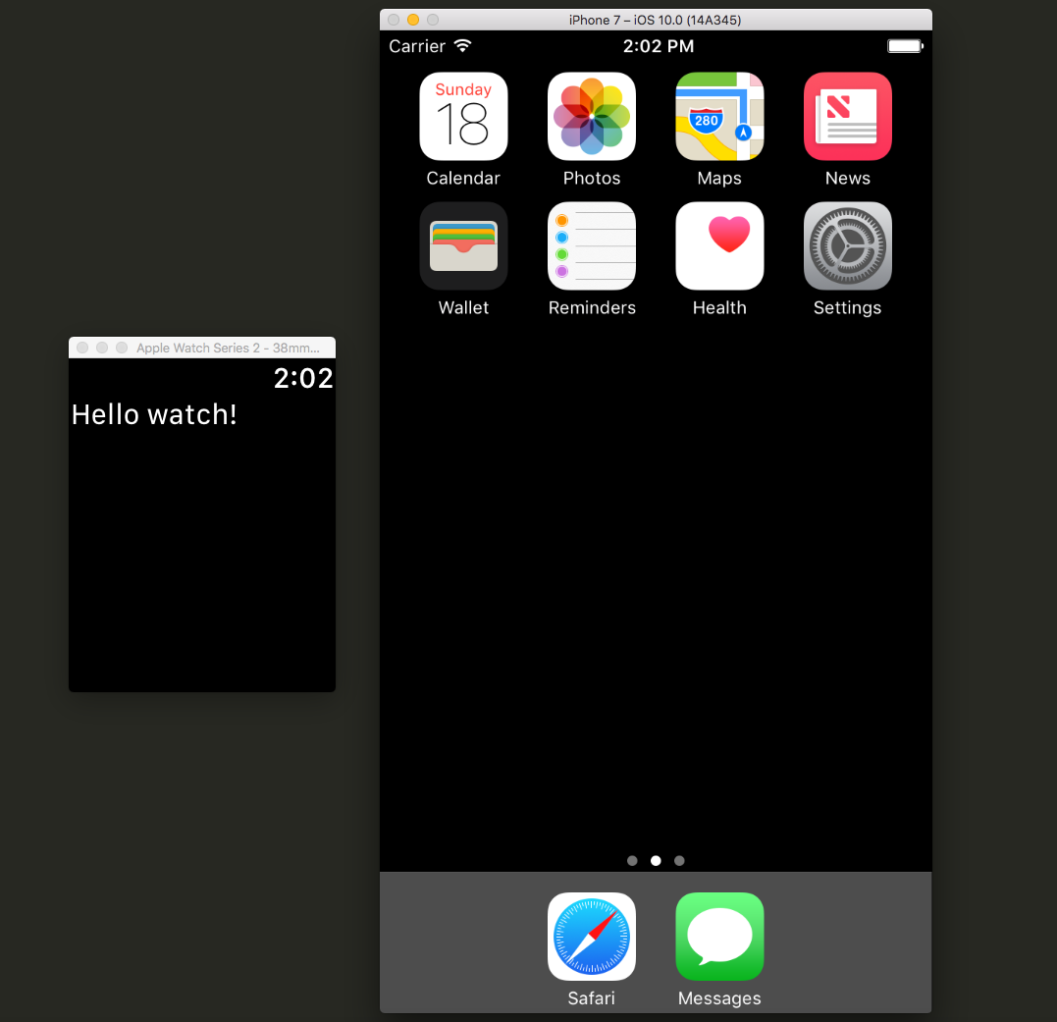
Launch the App!
Notes:
We'll pause here and walk around to see that everyone is up to speed

Slide 19
Watch Counter App (with iPhone Companion App)

Slide 20
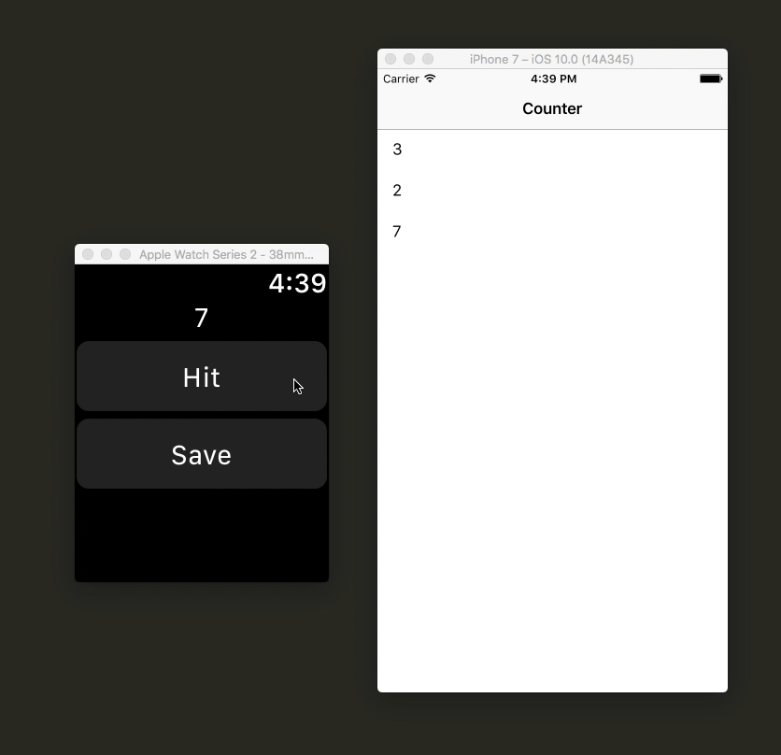
Final Product
Increment
Notes:
iPhone app already done, we’re just going to work on the watch part

Slide 21
Counter Application
Open the Xcode project (Counter.xcodeproj)
bit.ly/ghcwatch

Slide 22

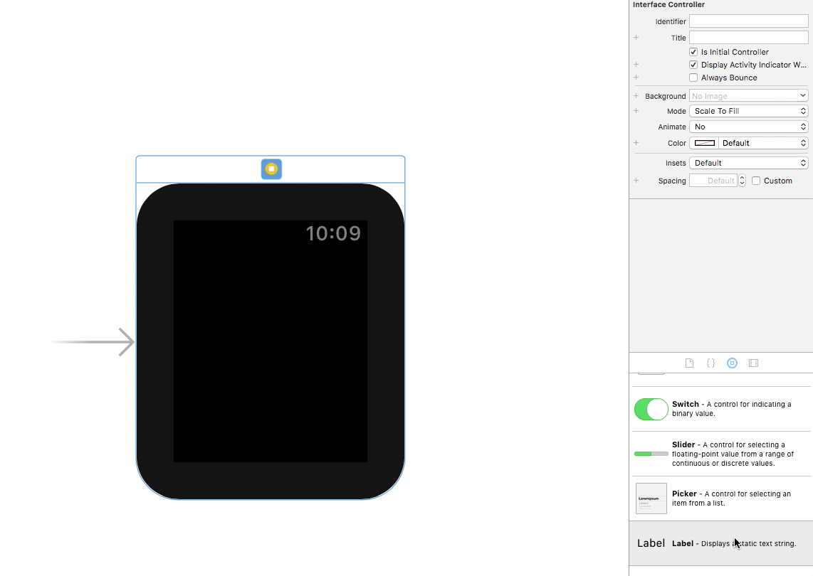
Setup the Counter Label
Notes:
Look for the bookmark arrow – second from the right

Slide 23
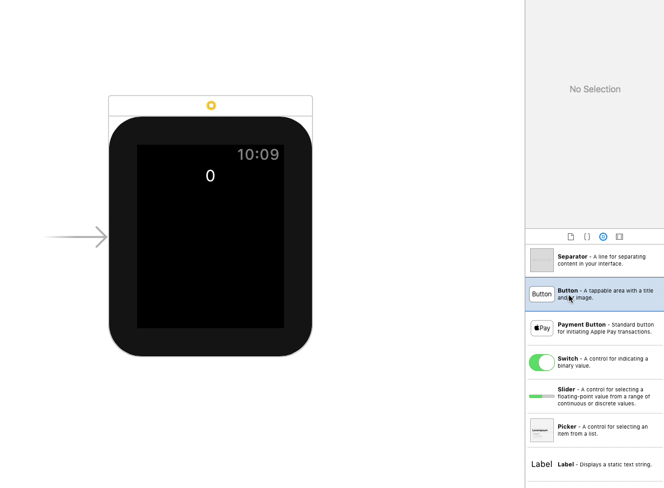
Add the buttons

Slide 24
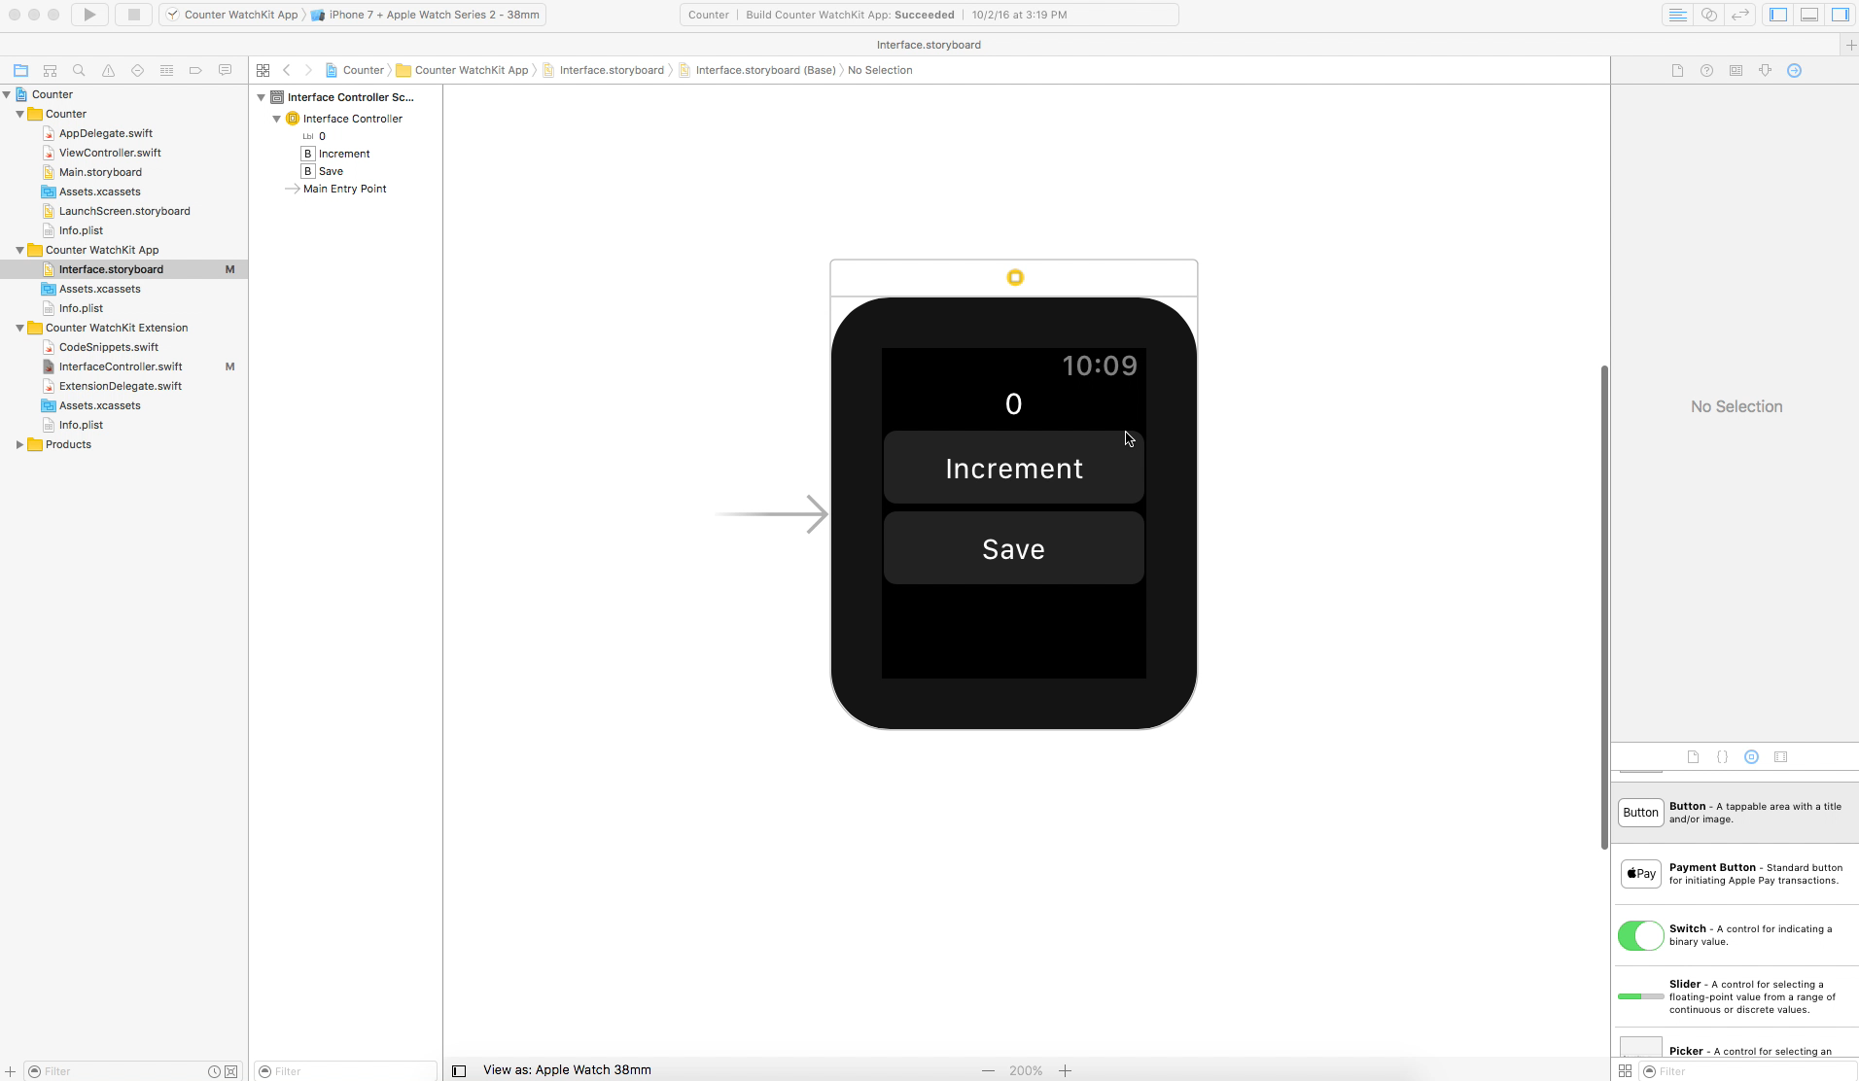
Go into split view

Slide 25
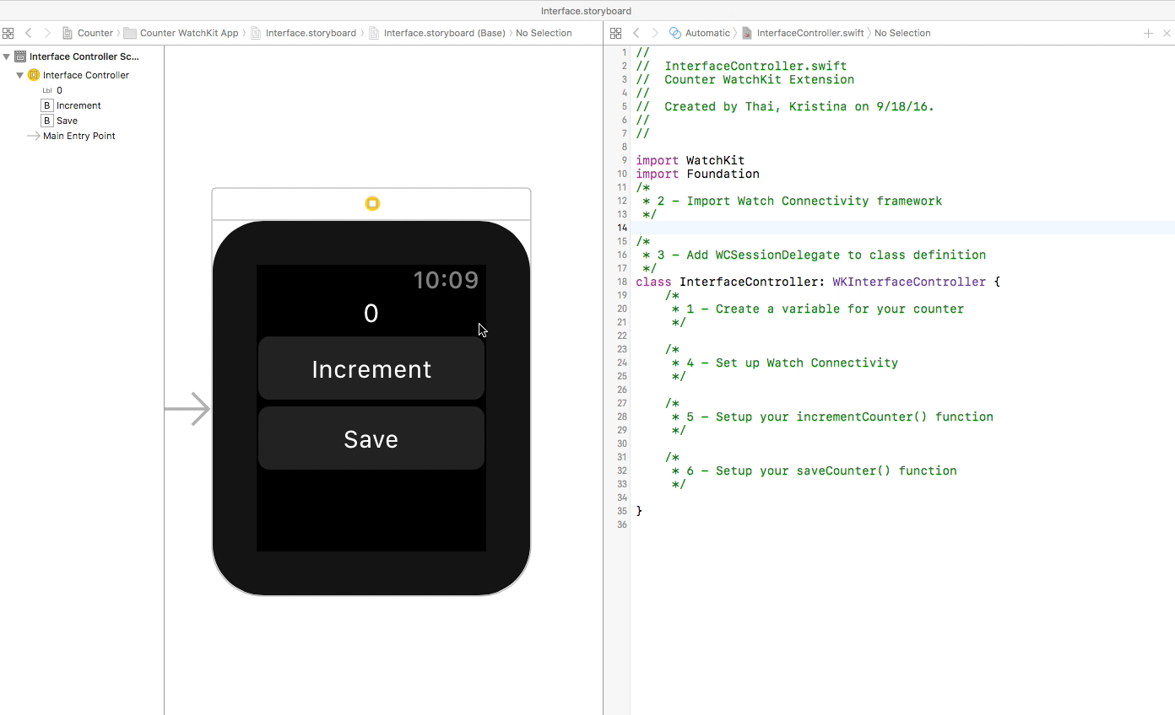
Connect the counter label outlet

Slide 26
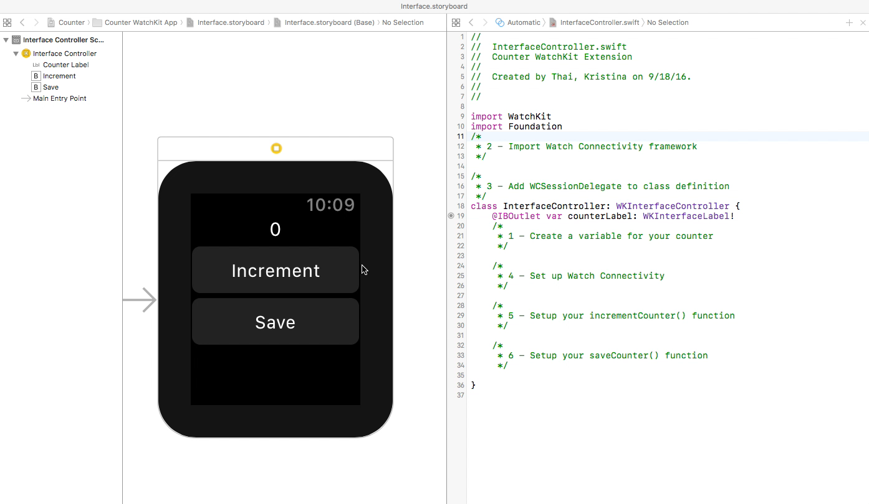
Connect the button actions

Slide 27
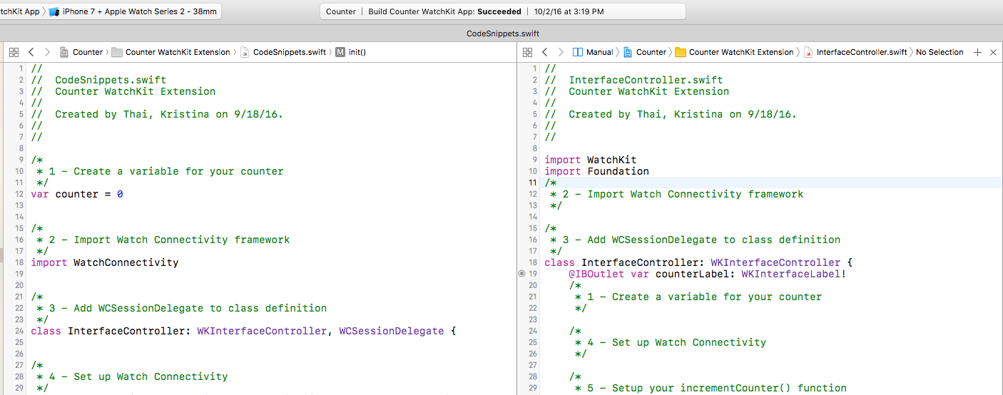
Time to code!
On the left sidebar, go to the Counter WatchKit Extension folder and click on
“CodeSnippets.swift”
Hold down the Option key and click on “InterfaceController.swift”

Slide 28
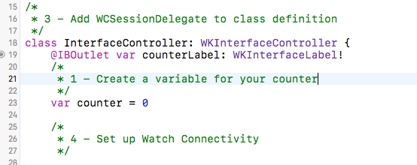
1 – Create a variable for your counter

Slide 29
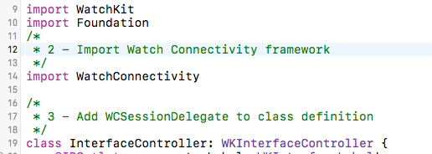
2 – Import Watch Connectivity framework

Slide 30
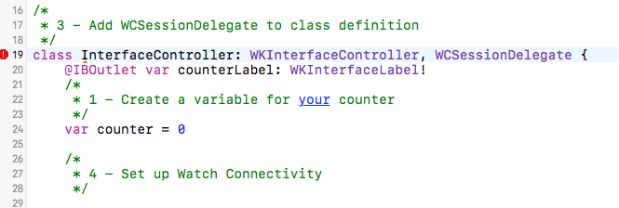
3 – Add WCSessionDelegate to class definition
Notes:
Delegate allows us to say we’re supporting Watch Connectivity in this file
Don’t worry if you see an error pop up, we’ll fix this in the next step

Slide 31
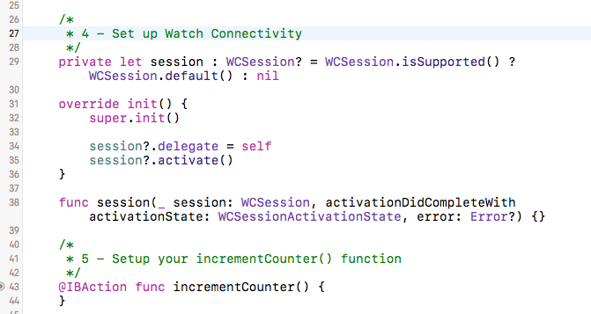
4 – Setup Watch Connectivity
Notes:
opens up the connection between the watch and the phone
Notice that the error goes away now that we’ve set up the necessary function for the WCSession delegate

Slide 32
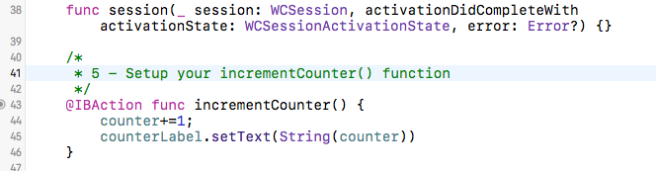
5 – Setup your incrementCounter() function
Notes:
copy and paste the code INTO the saveCounter function

Slide 33
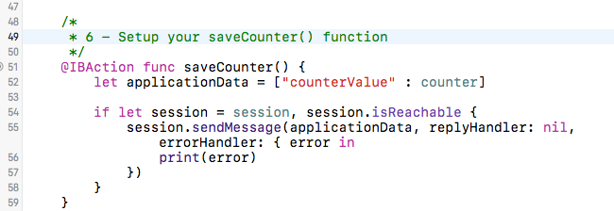
6 – Setup your saveCounter() function
Notes:
copy and paste the code INTO the incrementCounter function

Slide 34
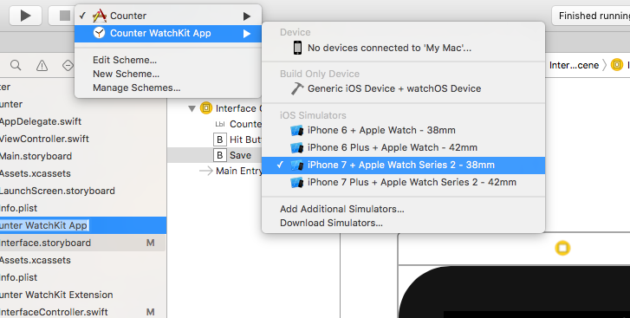
Choose Your Scheme…and Run!
Notes:
Remember, iPhone app is already done so it should just work for you now if you’ve done the watch correctly

Slide 35
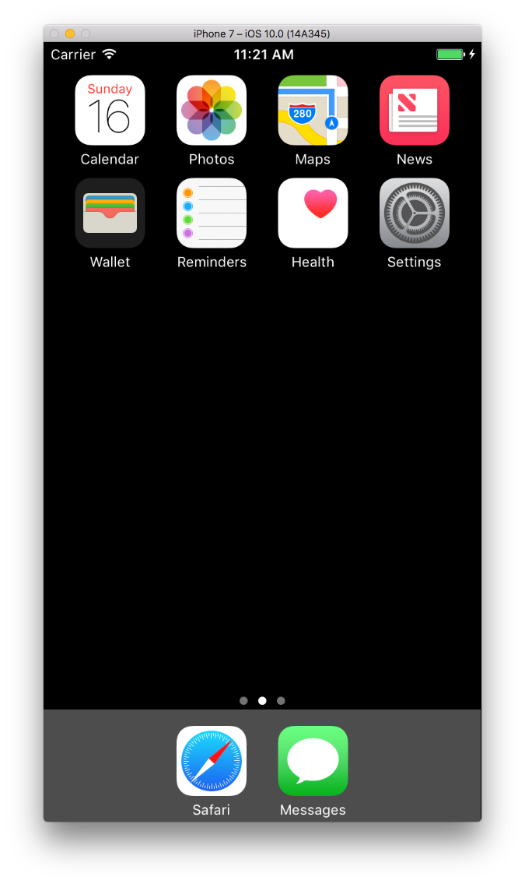
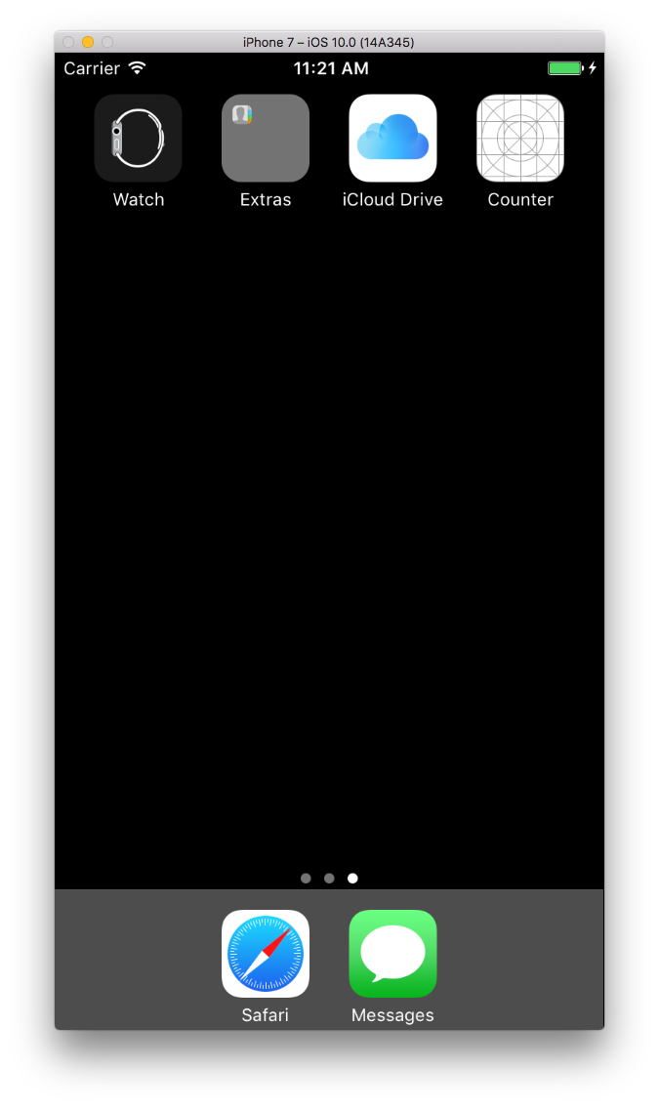
Open the Counter app on the iPhone
Swipe left to get to the 2nd page
Click on the
Counter app
Notes:
Your watch app will launch by itself. You need to manually launch the phone app

Slide 36
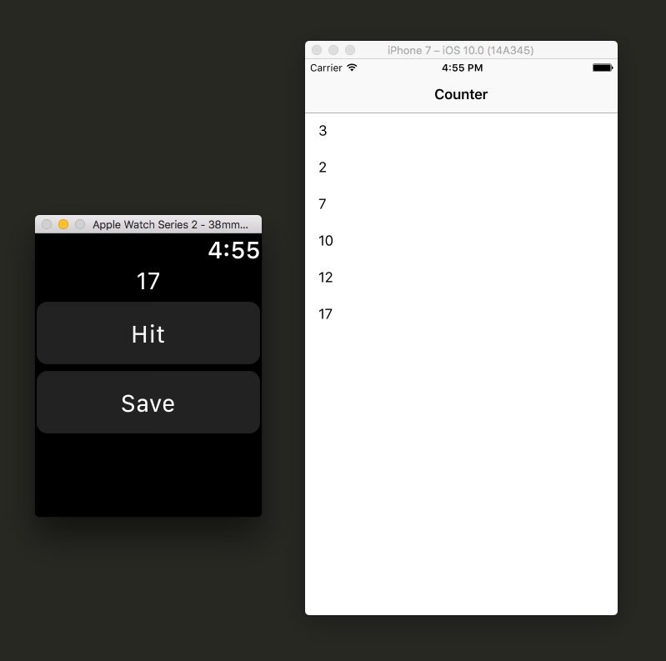
Counter Application
Increment
Notes:
It will take a long time for your watch & iPhone apps to load
Watch Connectivity may not work very fast either – make sure you don’t have any error messages in your console

Slide 37
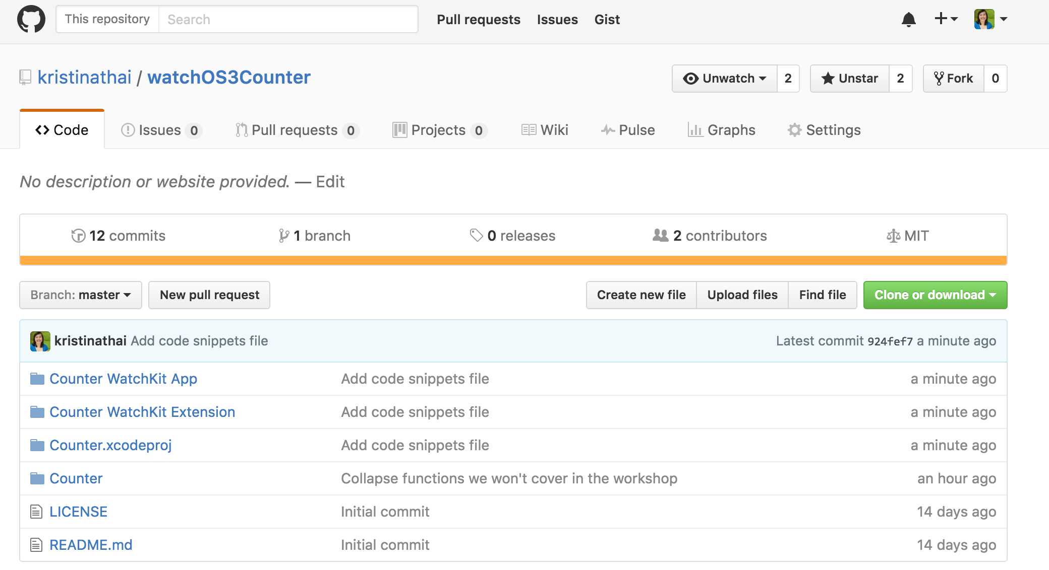
Final Project Code
https://github.com/krstnfx/watchOSCounter

Slide 38
Apple Ecosystem

Slide 39
Apple Ecosystem

Slide 40
Apple Ecosystem

Slide 41
Resources and Q&A

Slide 42
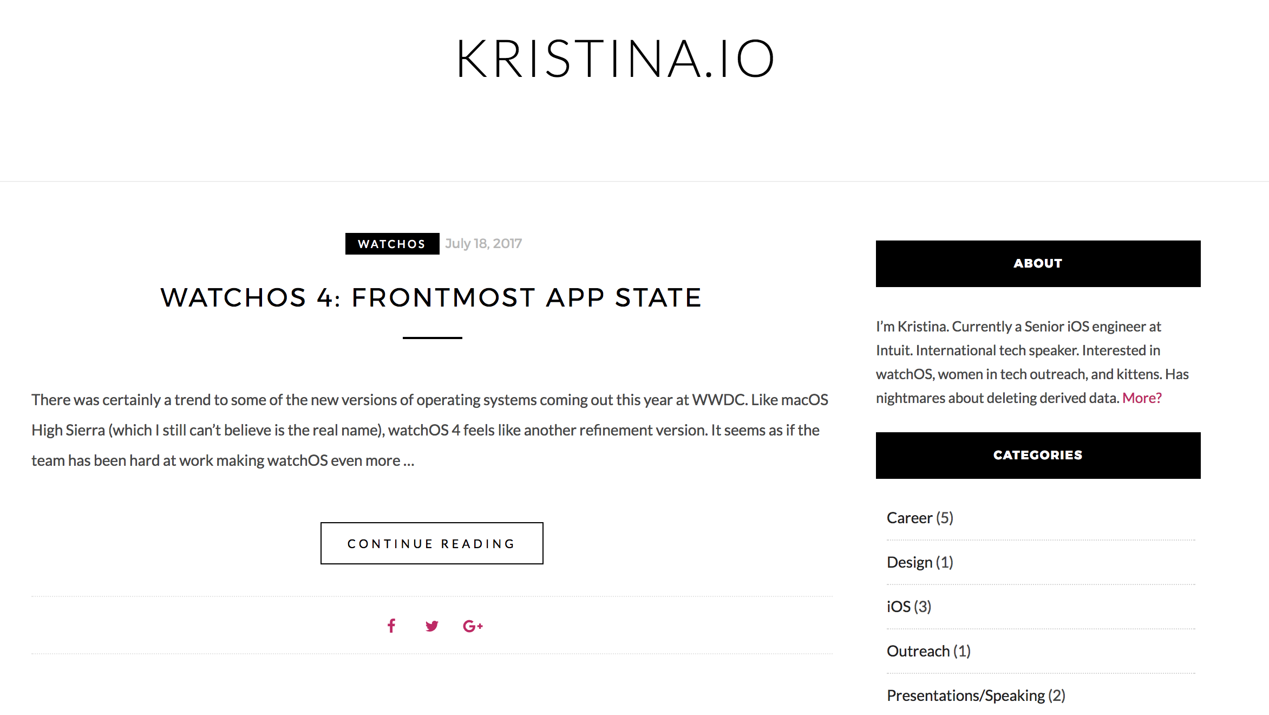
Kristina’s iOS & watchOS Blog

Slide 43
Resources
App Programming Guide for Apple Watch
Apple Watch Human Interface Guidelines
Ray Wenderlich
Natasha the Robot

Slide 44

Thanks!
Kristina Fox
@krstnfx
Kristina.io

